Slide 1
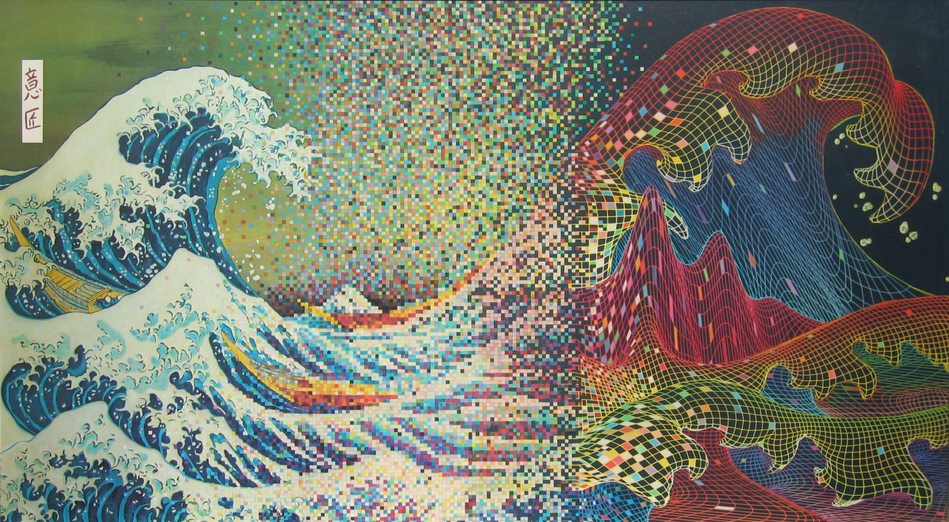




ANALYSIS OF EEG DATA
Kyle E. Mathewson
Director, Attention, Perception, and Performance Lab
Assistant Professor, Department of Psychology
Affiliate, Neuroscience and Mental Health Institute

Slide 2
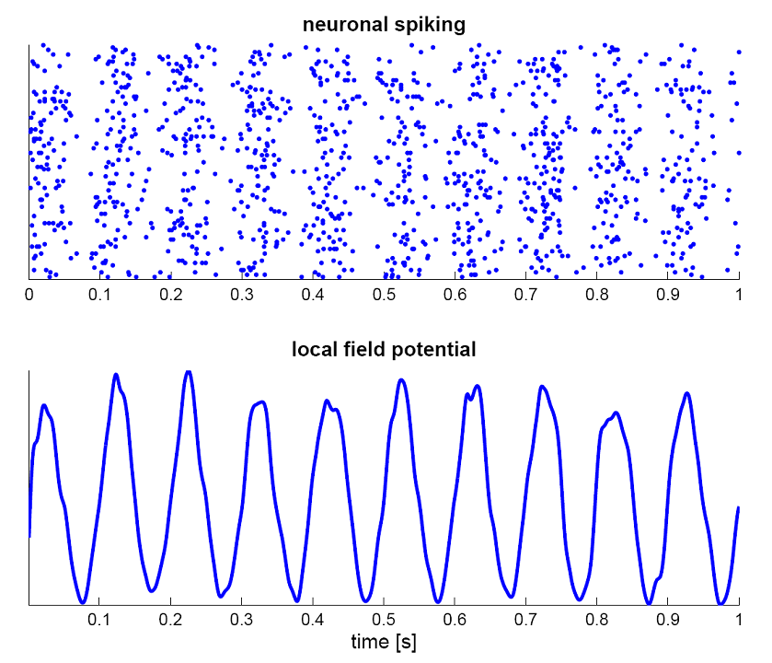
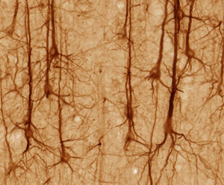

Slide 3
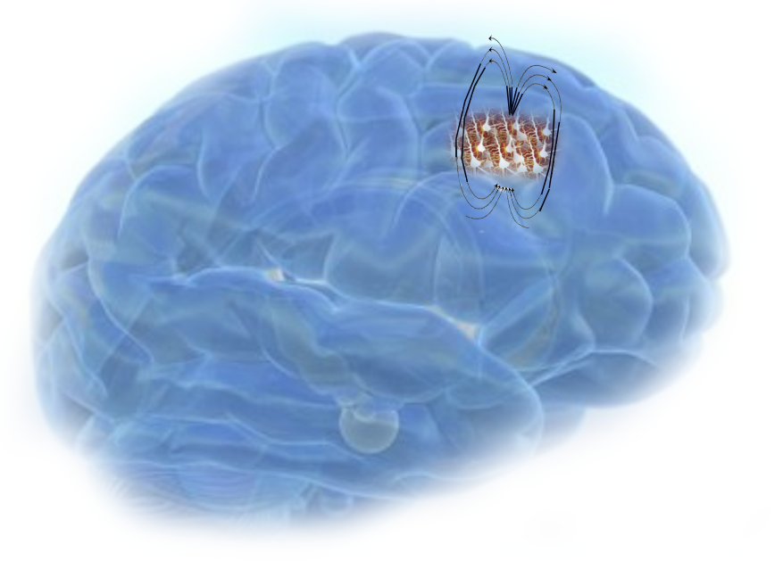

Slide 4
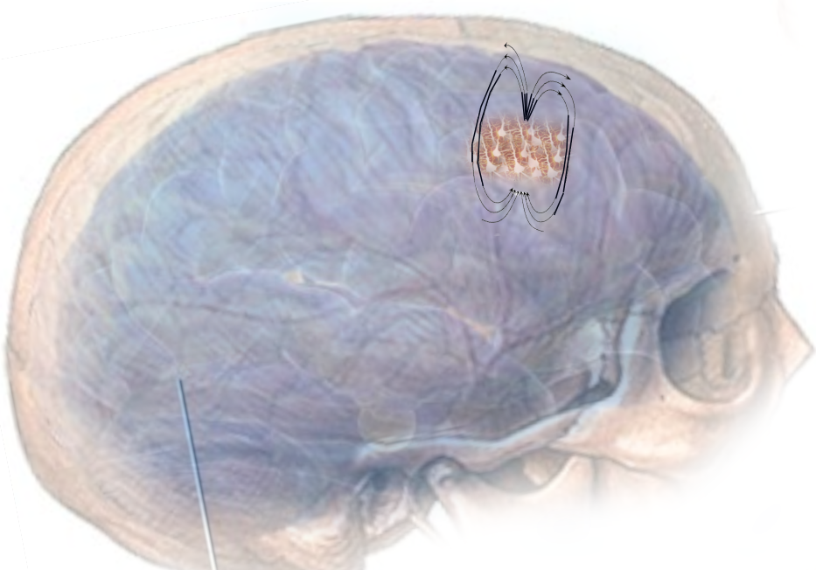

Slide 5
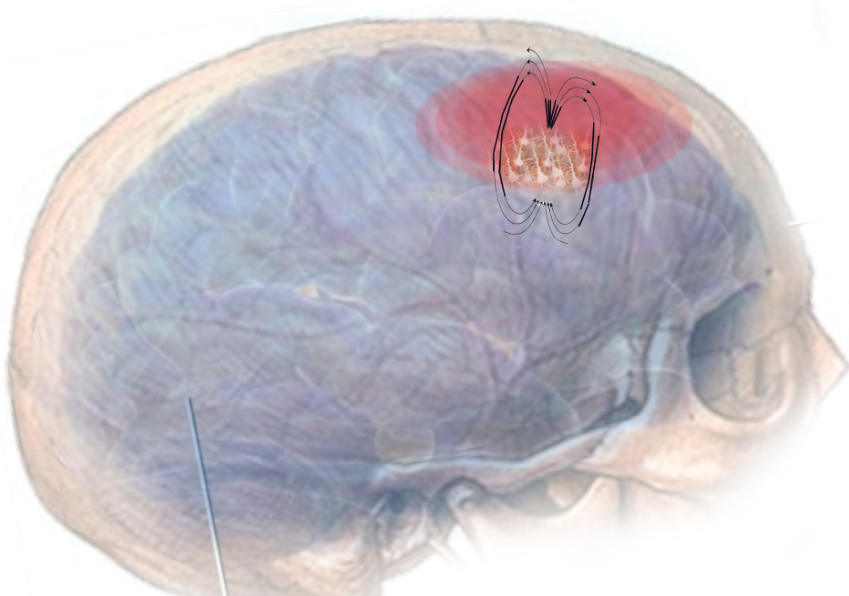

Slide 6
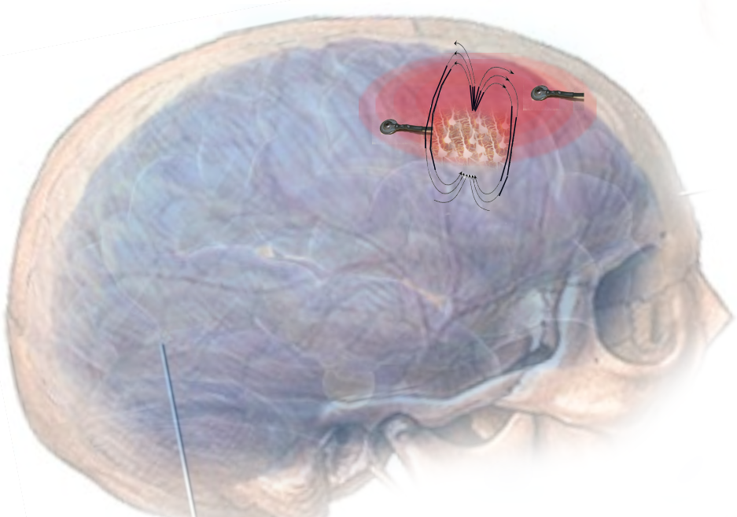

Slide 7
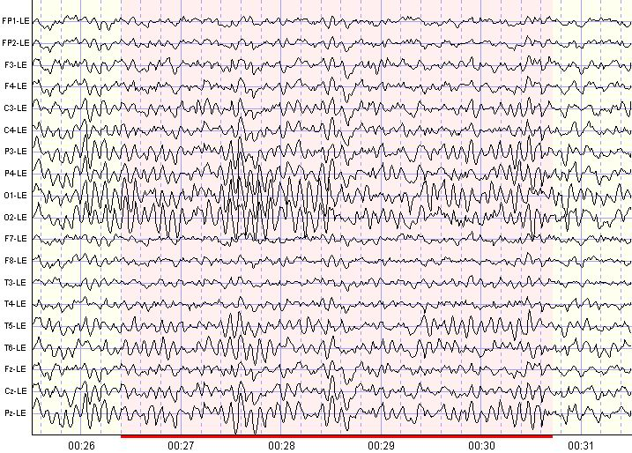
EEG

Slide 8
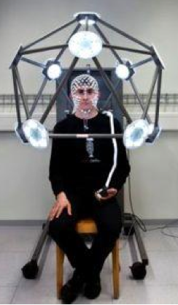

Slide 9
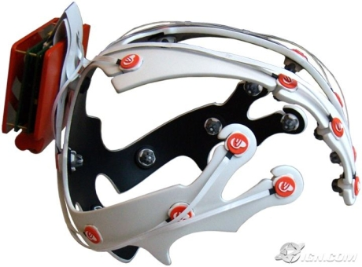
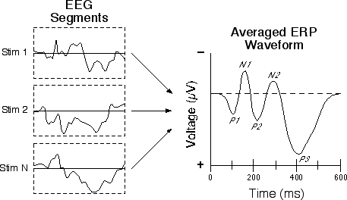

Slide 10
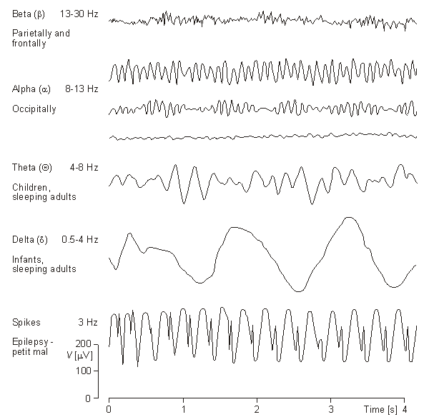

Slide 11
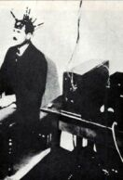
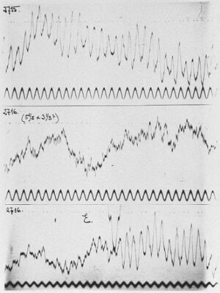
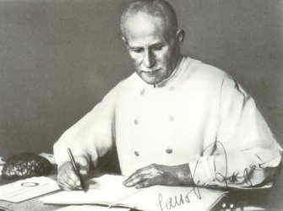
Alpha – 8-13 Hz

Slide 12
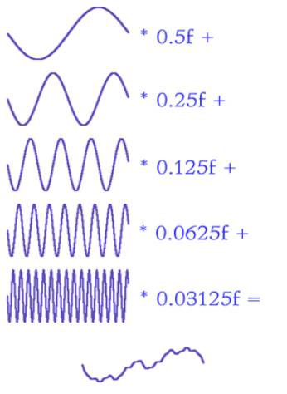
Fourier Transform

Slide 13
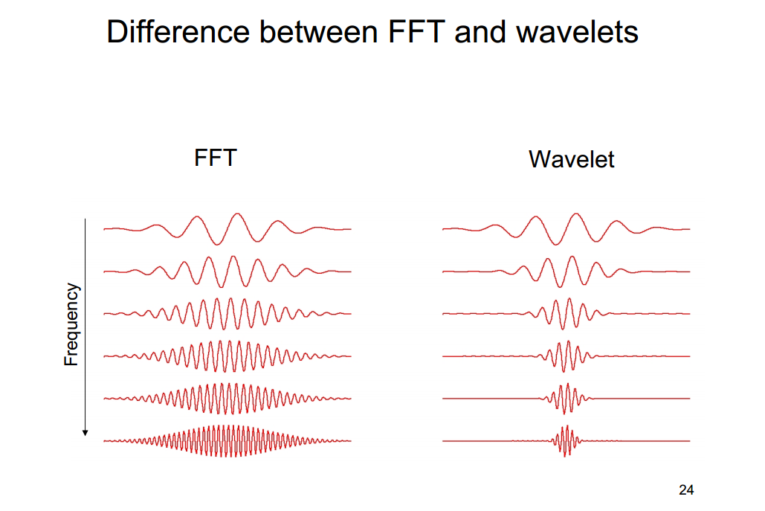
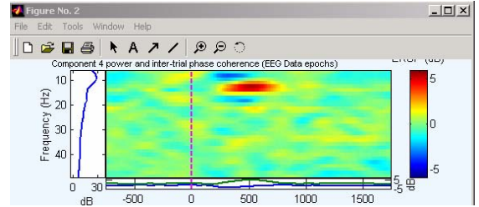
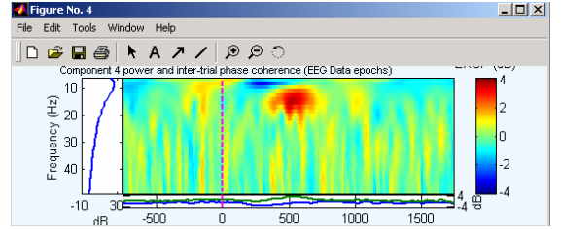

Slide 14
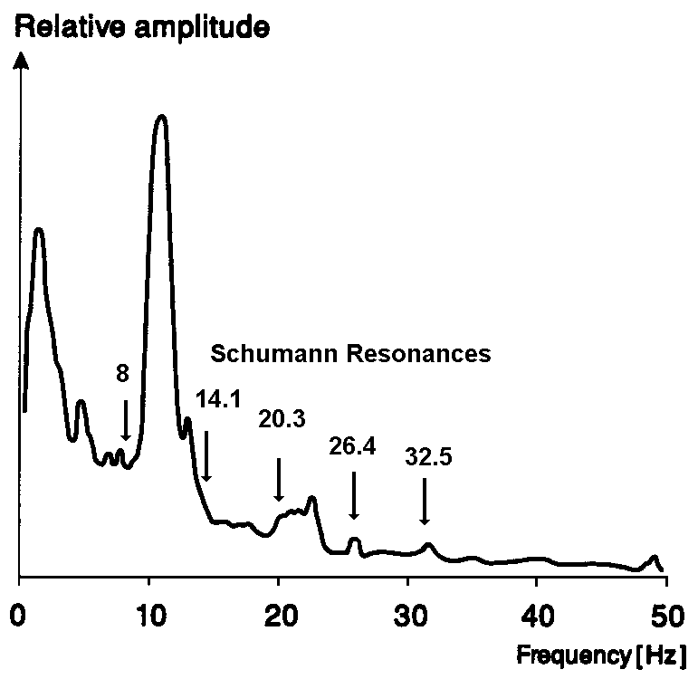
Frequency Analysis
c
Frequency Spectra
Power & Phase
c
c
Average Frequency Spectra

Slide 15
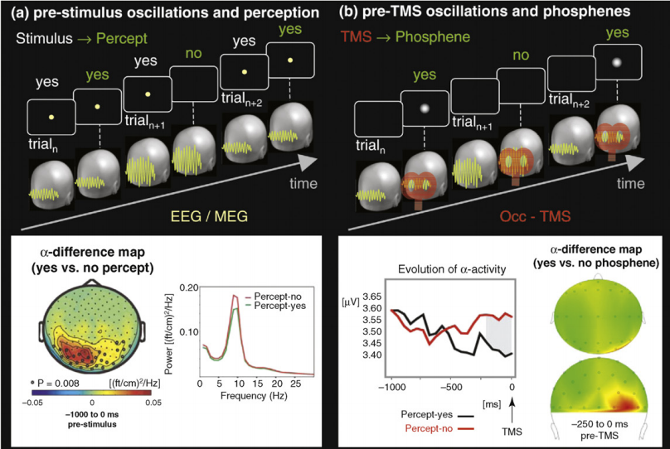
Thut and Miniussi, TICS, 2009

Slide 16
2º
+
.5º
1º
1º
Fixation
247 ms
Blank
400 ms
Target
11.7 ms
ISI
46.8 ms
Mask
23.4 ms
Response
~1520 ms
+
Trial
2220 ms
Mathewson, Gratton, Fabiani, Beck, and Ro, Journal of Neuroscience, 2009

Slide 17
247 ms Fixation

Slide 18
400 ms Blank

Slide 19
11 ms Target

Slide 20
11 ms Mask

Slide 21
48 ms SOA

Slide 22
~1520 ms Response Period

Slide 23
Post-Stim. ERP differences
N1
P3
Fz
-3
-2
Undetected
Detected
-1
Voltage (uV)
Voltage (uV)
Pz
0
1
2
3
-200
-100
100
200
300
400
500
600
Target Onset
Time (ms)
Oz
P1
P2

Slide 24
I can normally see fine, I’m just going through a PHASE
-0.3
Pz
0
Voltage (uV)
0.3
Undetected
Detected
0.6
-100
-50
Target Onset
50
100
Time (ms)
Mathewson, Gratton, Fabiani, Beck, and Ro, Journal of Neuroscience, 2009

Slide 25
Alpha is bad for seeing…
Detection Rate (%)
*
α Power Quartile
Mathewson, Gratton, Fabiani, Beck, and Ro, Journal of Neuroscience, 2009

Slide 26
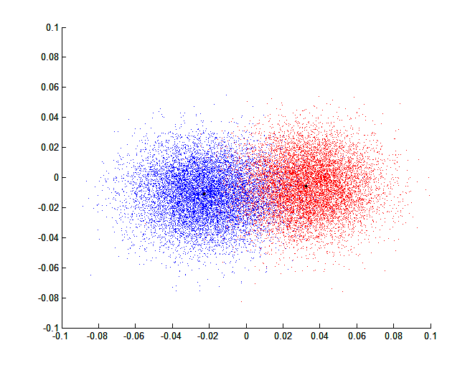
C
D
0
0
6
5
4
3
2
1
6
5
4
3
2
1
270
90
270
90
180
Undetected
180
Detected
E
Undetected - Detected
0
270
90
180
Mathewson et al., JoN, 2009

Slide 27
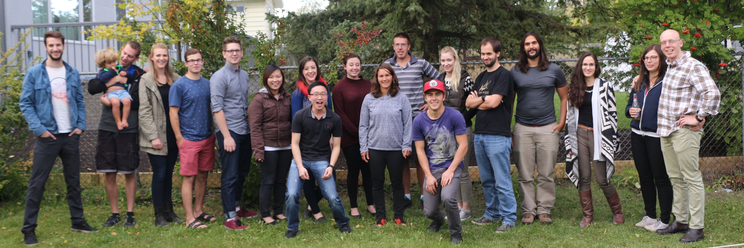
Thanks for your waves of attention
Kyle E. Mathewson
Director, Attention, Perception, and Performance Lab
Assistant Professor, Department of Psychology
Affiliate, Neuroscience and Mental Health Institute

